Slide 1



DRAINPOWER.EU
Harnessing the Untapped for a Warmer Tomorrow
NVCP Project 2023/2024 Group RENE24_16

Slide 2
















MEET THE TEAM
Meie Kleijburg CTO
Philina Niederkofler CFO
Patrick Doran CEO
Maria Tavares CCO
Mikhil V. J. CGO

Slide 3
Table of content
1. Problem/solution
2. Market Analysis
3. validations
4. Finance

Slide 4

The PROBLEM
Energy waste
Efficiency loss in cold climates
Environmental impact

Slide 5
thermal energy consumption In Buildings
Wh
Shower 10min
3.190
Washing Machine
Dishwasher
Wallbox 1 hour (Slow Charger)
3.000
Charging Phone for 1 year
3.650
[EKZ, 2021], [Utopia, 2022)]
Notes:
Dishwasher energy: https://www.ekz.ch/de/blue/wissen/2021/die-spuelmaschine-am-abend-oder-in-der-nacht-laufen-lassen.html#:~:text=Ein%20Geschirrsp%C3%BCler%20verbraucht%20pro%20Waschgang,7%20Liter%20Wasser.
Washing mashine: https://utopia.de/ratgeber/wie-viel-energie-verbraucht-ein-waschmaschinen-durchgang-und-was-kostet-das/

Slide 6


Our SOLUTION – Drain Water Heat Pump
DrainPower introduces transformative solutions to revolutionize heating systems.
DWHP
Thermal Energy
🔥 >3.5kW
🔥 4.5kW
Drain Water
Household Water
Electricity
Optimisation Platform
⚡ 1kW
Notes:
Our solution is a drain water heat pump. Typically, thermal energy from drain water, at around 20°C, is wasted. Our system captures this energy, compresses it using electricity, and reinjects it to reheat household water, achieving an efficiency of about 450%.
How It Works:
Capture: Drain water thermal energy is captured instead of going into the sewage system.
Compress: This energy is compressed using electricity.
Reinject: The compressed energy is used to reheat household water, providing a highly efficient solution.

Slide 7





COMPANY ECOSYSTEM & PARTNERS
Installation Company
Heat Pump Supplier
Based in Baden-Württemberg, Germany
HP Equipment
Manufacturer from Germany
Installation & Maintenance
DrainPower HeatPump and Monitoring Software
Heat Exchanger
B2B Hotels, Hospitals etc.
Notes:
To put the whole system into perspective, we have established a robust value ecosystem that integrates various key components:
Drain Water Energy Capture: We capture thermal energy from drain water that would otherwise be wasted.
Heat Pump Integration: We source high-quality heat pumps from reputable manufacturers like Viessmann, Bosch, and LG. These pumps are then integrated with our proprietary heat exchanger system.
Installation Partnerships: We collaborate with professional installers to ensure seamless and efficient installation of our systems in homes and commercial buildings. This process is comparable to the installation of regular air source heat pumps, minimizing disruption and complexity.
Energy Compression and Reuse: The captured thermal energy is compressed using electricity and then reused to heat household water, significantly enhancing energy efficiency.
Maintenance and Support: Our revenue model includes maintenance services, ensuring the longevity and optimal performance of the systems. We provide ongoing support through a subscription platform that offers real-time feedback on heat consumption and optimization tips.
Customer Relationships: We build strong relationships with customers through direct sales channels and partnerships with hotel chains and smaller hospitality providers. This approach allows us to scale gradually while maintaining a high level of service and customer satisfaction.

Slide 8
Table of content
1. Problem/solution
2. Market Analysis
3. validations
4. Finance

Slide 9
European Market Size
CAGR 18% (2024-2032)
TAM €15.8B
Total Addressable Market
Maximum market potential of heat pumps [GMI].
SAM
€1.2B
Serviceable Addressable Market
Northern/central Europe, in colder regions [PLOS] and commercial buildings (hotels, hospitals, universities, etc.) [Cordis –EU Commission].
SOM €100M
Serviceable Obtainable Market
Larger commercial buildings (hotels, hospitals, universities, etc.) [Cordis –EU Commission]
Notes:
The total market for thermal systems in Europe is €15.8 billion, with colder climates representing a €4.9 billion market. Our target market, initially valued at €1.2B, is expected to grow at an 18% CAGR from 2024 to 2030.
SAM = 30%
SOM =20%
Commercial Heat Pump Market Share | Analysis Report, 2032 (gminsights.com)

Slide 10






Competitor Analysis
Air-Source Heat-Pumps
Conventional
Heating Systems
Notes:
We compare our solution to traditional heating solutions and air source heat pumps. While traditional systems maintain consistent efficiency, they cap at around 90%. Air source heat pumps can reach 350% efficiency but only under ideal conditions and drop significantly in colder climates. Our system provides a consistent efficiency of about 450%, filling a crucial market gap.

Slide 11
Table of content
1. Problem/solution
2. Market Analysis
3. validations
4. Finance

Slide 12




Customer validations
"It would help me cut down on heating costs."
Private Equity owner in Austria
"CAPEX is not necessarily a problem if the investment pays off."
Hotel owner in Germany
"It helps in the congestion problem, has economical incentives, and clearly also the reduction of CO2."
Energy Manager at TU Eindhoven
"We just have too much work to do."
Campus Manager in the Netherlands
"The approach sounds exciting and also very sustainable."
Property manager in Austria
Notes:
Selling it: 1) validation phase; spoke to customers and what did they find. Add quotes.
Partnerships: We buy heat pumps from manufacturers like Viessmann, Bosch, and LG, and integrate our heat exchanger system.
Installation: We partner with installers to ensure easy and efficient on-site installations, similar to regular air source heat pumps.
Revenue Streams: Revenue will come from sales of the drain water heat pump, maintenance services, and a subscription platform that provides feedback on heat consumption optimization.
Product Sales: Selling the drain water heat pumps.
Maintenance Services: Regular maintenance and optimization services.
Subscription Platform: Providing feedback on heat consumption optimization.

Slide 13
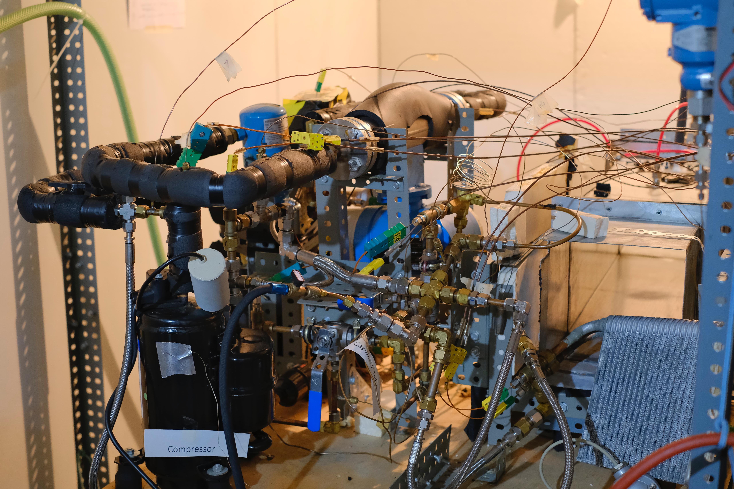
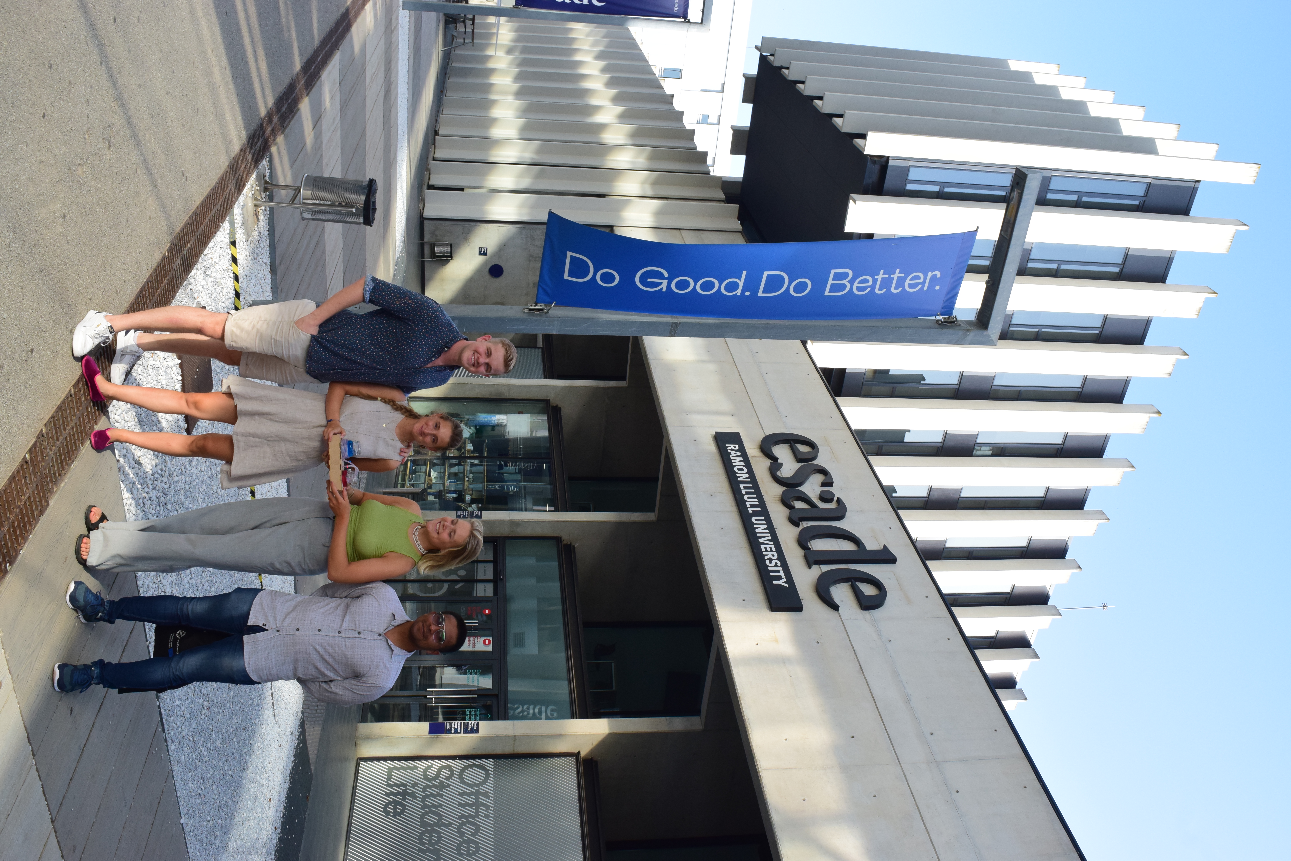
Minimum Viable Product

Slide 14
Case Study on Drain Water Heat Pump
Medium Sized Hotel (100 beds)
Based in the south of Germany
Air-Water HP
DrainWater HP
Test Site:
Unit Cost | 100,000 € | 140,000 €
Heat Cost annual | 36,677 € | 25,142 €
Maintenance annual | 1,000 € | 5,000 €
Resulted in: 32% reduction of heating expenses, 5 years payback period, 20 years IRR of 21% (of the surplus Investment) and 14,5 t of annual CO2 savings
Notes:
With Inflation of 2%.year, Discount rate 5%.year.

Slide 15
Table of content
1. Problem/solution
2. Market Analysis
3. validations
4. Finance

Slide 16
Pricing Strategy
Discount
10,000€
Gross Profit Margin
24,900€
Installation
5,000€
 | Maintenance | Optimising Platform
Revenue per Year | 5,000€ | 1,000€
Installers Margin | 3,000€
Shipping
100€
140,000€
Heat Exchanger
9,000€
Heat Pump
100,000€
Notes:
Pricing Strategy: The product is priced at €140,000. Initial sales will be discounted by €10,000 to attract early adopters.
Cost Structure: We buy heat pumps for €100,000, our heat exchanger costs €9,000 to produce, with shipping and installation costing €5,100. This gives us an initial profit margin of €24,900.

Slide 17
Implementation Plan
2024
2025
2026
2027
Activity
Q3
Q4
Q1
Q2
Q3
Q4
Q1
Q2
Q3
Q4
Q1
Q2
Q3
Q4
Investment
Non-Dilutive
FFF
20k€
Pitch Contests ~15k€
0% Interest Loan 200k€
Bank Loan 200k€
Equity
Angel Investment 50-100k€
VC
1-1.5 Mio.€
Product Development
Patenting
Patent Filed
Patent Publicised
Manufacturing (Outsourced)
Commercial MVP
Pre-Series
Series-Production
Notes:
2025: File patents and start commercial MVPs with discounted trials. 2026: Begin pre-production. Post-2026: Move to full-scale production, improving profit margins with higher quantities. Early 2025: Seeking family, friends, and pitch contest funding (~€70,000).
Further Funding: Interest-free loans from the German Federal State department (up to €200,000) and equity investment from angel investors and venture capital by 2027.

Slide 18
Sales forecast
1.800.000
1.600.000
1.400.000
Net Income
€ Net Income (Quarterly)
1.200.000
Sales
1.000.000
Units Sold
800.000
600.000
400.000
Series
200.000
Commercial MVP
Pre-Series
0
-200.000
Acc.: -139.1k€
2024
2025
2026
2027
2028
2029
Notes:
Revenue Projections: We project significant growth post-commercial MVP, with a negative cash flow of €127,000 transitioning to positive cash flow upon reaching pre-production.
Annahmen: starting with a commercial MVP and with one project per quarter, with sales then slowely increasing
In the beginning, we have a negative income for the first 4 quarters as is visible from the implementation plan, which adds up to losses mounting up to 19k €. Once we start selling our commercial MVP, we can move into positive CF, although it still remains low until the start of pre production. When we go into series production, there is an even bigger increase and the units sold . The net profit is then increasing faster then the units sold, which is due to the fact that the production costs decreased when moving into series production

Slide 19

Investor Exit Strategy
IPO
Acquisition: Competitor Analysis shows “Big Players” in the Heat Pump Market
Bosch just acquired Johnson-Hitachi for 7.4 billion euros
Carrier acquired Viessmann's Heat Sector for 12 billion euros earlier this year (Viessmann Heat Pump Sales 2021: 120.000 Units)
Liquidation: Risk mitigation through investment in Patent
Notes:
IPO or Acquisition: Given the market activity, with significant acquisitions like Bosch acquiring Hitachi for €7.5 billion and Carrier acquiring Viessmann for €12 billion, there are substantial exit opportunities for investors.

Slide 20


Slide 21


Slide 22
Backup
Intellectual Property Rights
UPC TES Lab
Sales Funnel
Operations Plan
HR Plan
Thermodynamics of a Heat Pump
Financial Model (Excel)

Slide 23
Current IPR Situation
Heat Recovery Systems:
CN103344064A – Chinese Patent by JIANGSU TENESUN HEAT PUMP CO – Use a tank
DE3006119A1 – German Patent by LUKA HANS
Notes:
Dishwasher energy: https://www.ekz.ch/de/blue/wissen/2021/die-spuelmaschine-am-abend-oder-in-der-nacht-laufen-lassen.html#:~:text=Ein%20Geschirrsp%C3%BCler%20verbraucht%20pro%20Waschgang,7%20Liter%20Wasser.
Washing mashine: https://utopia.de/ratgeber/wie-viel-energie-verbraucht-ein-waschmaschinen-durchgang-und-was-kostet-das/

Slide 24

Current IPR Situation
Preventive Systems against Biofouling:
WO2018175374A1 – Ultrasound system to prevent biofouling
US7650848B2 – Sharklet Skin to prevent biofouling (Sharklet holds a total of 11 patents on this research area)
We claim: 1. An article having a surface topography for resisting bioadhesion of organisms, comprising:
a base article having a surface,
wherein a composition of said surface comprises a polymer,
wherein said surface has a topography comprising a plurality of repeated patterns, each pattern being defined by a plurality of spaced apart features attached to or projected into said base article, each feature being a single elongate structure extending longitudinally along the surface of the base article,
said plurality of features each having at least one microscale dimension, each feature further having at least one neighboring feature having a substantially different geometry,
wherein an average first feature spacing between adjacent ones of said features is between 10 μm and 100 μm in at least a portion of said surface,
wherein said plurality of repeated patterns is separated by a pathway that is sinusoidal in shape.
Notes:
Dishwasher energy: https://www.ekz.ch/de/blue/wissen/2021/die-spuelmaschine-am-abend-oder-in-der-nacht-laufen-lassen.html#:~:text=Ein%20Geschirrsp%C3%BCler%20verbraucht%20pro%20Waschgang,7%20Liter%20Wasser.
Washing mashine: https://utopia.de/ratgeber/wie-viel-energie-verbraucht-ein-waschmaschinen-durchgang-und-was-kostet-das/

Slide 25
Backup
Intellectual Property Rights
UPC TES Lab
Sales Funnel
Operations Plan
HR Plan
Thermodynamics of a Heat Pump
Financial Model (Excel)

Slide 26
2024
2025
2026
2027
2028
Activity
Q3
Q4
Q1
Q2
Q3
Q4
Q1
Q2
Q3
Q4
Q1
Q2
Q3
Q4
Q1
Q2
Q3
Q4
Non-Dilutive
FFF & Contests
O% Interest Loan
Bank Loan
Equity
Angel Investment
VC
Company Development
Patent Filing
Commercial MVP
Pre-Series
Series
Patrick Doran
Philina Niederkofler
Meie Kleijburg
Maria Tavares
Mikhi V.J.
20k€ yearly Salary
80k€ yearly Salary
Mech. Engineer
Mech. Engineer
Manuf. Engineer
Sales Manager
Sales Manager
Marketing Manager
Notes:
IPO or Acquisition: Given the market activity, with significant acquisitions like Bosch acquiring Hitachi for €7.5 billion and Carrier acquiring Viessmann for €12 billion, there are substantial exit opportunities for investors.

Slide 27
Operations (work in process)
Strategic | Business development | Direct sales initially to hotels, expanding to chains Try to for cooperations with large hotel chains etc.
 | Mission, values | Not to let thermal energy stored in drain water go to waste.
 | Product/service development | HE addition to HP installment and maintenance training Outsourcing first, vertical integration after to improve Profit Margin
Operational | Source | Outsource production (heat exchanger / heat pump) in EUROPE (Germany) Storage Facility for HE (Initially, we can keep them at home.) Outsource delivery Office seats
 | Make | Training for installers Digital optimization platform Design team for coupling the HE in large variety of sites with the different purchased HP, as every case is different
 | Deliver | HP manufacturer delivers GW.HP to the site; at the same moment DP.HE™ and an (random trained by us) installer comes and does it.
 | Customer service | Chatbot/ Mail Physical maintenance annual Optimization platform (digital)
 | Continuous improvement | Vertical integration after
Support | HR | Small team oriented first, through outsourcing, so limited HR
 | Finance | Financial model simplified by purchasing external
 | IT

Slide 28
Backup
Intellectual Property Rights
UPC TES Lab
Sales Funnel
Operations Plan
HR Plan
Thermodynamics of a Heat Pump
Financial Model (Excel)

Slide 29
HR Strategy
2024
2025
2026
2027
2028
Activity
Q3
Q4
Q1
Q2
Q3
Q4
Q1
Q2
Q3
Q4
Q1
Q2
Q3
Q4
Q1
Q2
Q3
Q4
Patrick Doran
Philina Niederkofler
Meie Kleijburg
Maria Tavares
Mikhi V.J.
20k€ yearly Salary
80k€ yearly Salary
Mech. Engineer
Mech. Engineer
Manuf. Engineer
Sales Manager
Sales Manager
Marketing Manager
Company Development
Patent
Commercial MVP
Pre-Series
Series
Notes:
IPO or Acquisition: Given the market activity, with significant acquisitions like Bosch acquiring Hitachi for €7.5 billion and Carrier acquiring Viessmann for €12 billion, there are substantial exit opportunities for investors.

Slide 30
Backup
Intellectual Property Rights
UPC TES Lab
Sales Funnel
Operations Plan
HR Plan
Thermodynamics of a Heat Pump
Financial Model (Excel)

Slide 31
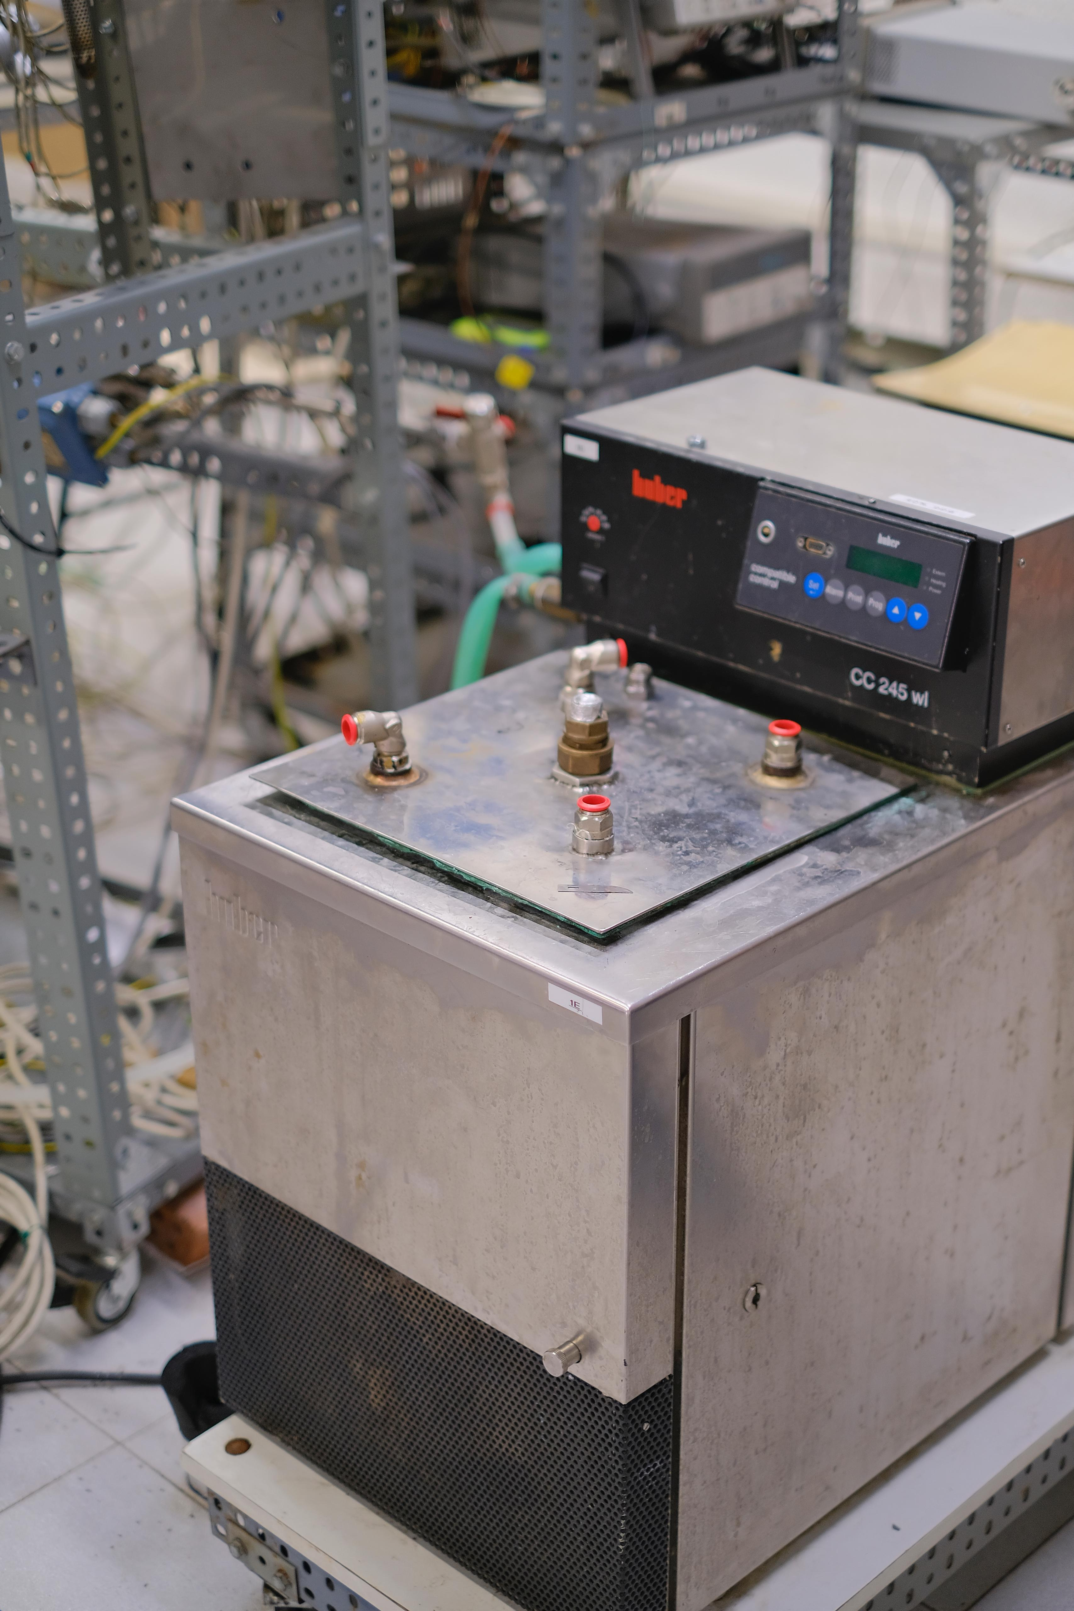


UPC TES LAb
Joaquim Rigola
Centre for Heat Transfer - UPC

Slide 32
Backup
Intellectual Property Rights
UPC TES Lab
Sales Funnel
Operations Plan
HR Plan
Thermodynamics of a Heat Pump
Financial Model (Excel)

Slide 33
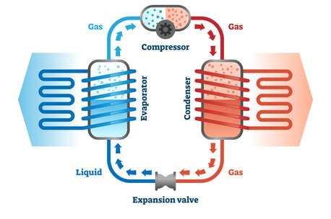
Thermodynamics of a heat pump
[Adobe Stock]
Notes:
Imágenes de Heat Pump Diagram: descubre bancos de fotos, ilustraciones, vectores y vídeos de 719 | Adobe Stock

